Slide 1
SAN LUIS OBISPO REGIONAL TRANSIT AUTHORITY
December 2, 2020
AGENDA ITEM: A-1
TOPIC: Executive Director’s Report
Recommendation: Receive as Information
PRESENTED BY: Geoff Straw

Slide 2
COVID-19 Response: Recent Actions
First full staff meeting since pandemic
External building customer intercom installed
Discussion on enhanced BMF air handling
Enhanced BMF HVAC submitted to contractor
Issued employee letters for curfew hours

Slide 3
Bus Maintenance Facility
Construction is on schedule and aiming for full completion in February 2022
Concrete Masonry Units on critical path
No safety incidents reported
Contaminated soil resolved fully
No archeological or biological assets discovered
Pouring 480 yards / 13k sq.ft. concrete Dec 8th
Three pay requests: C/Os in Agenda item C-7

Slide 4
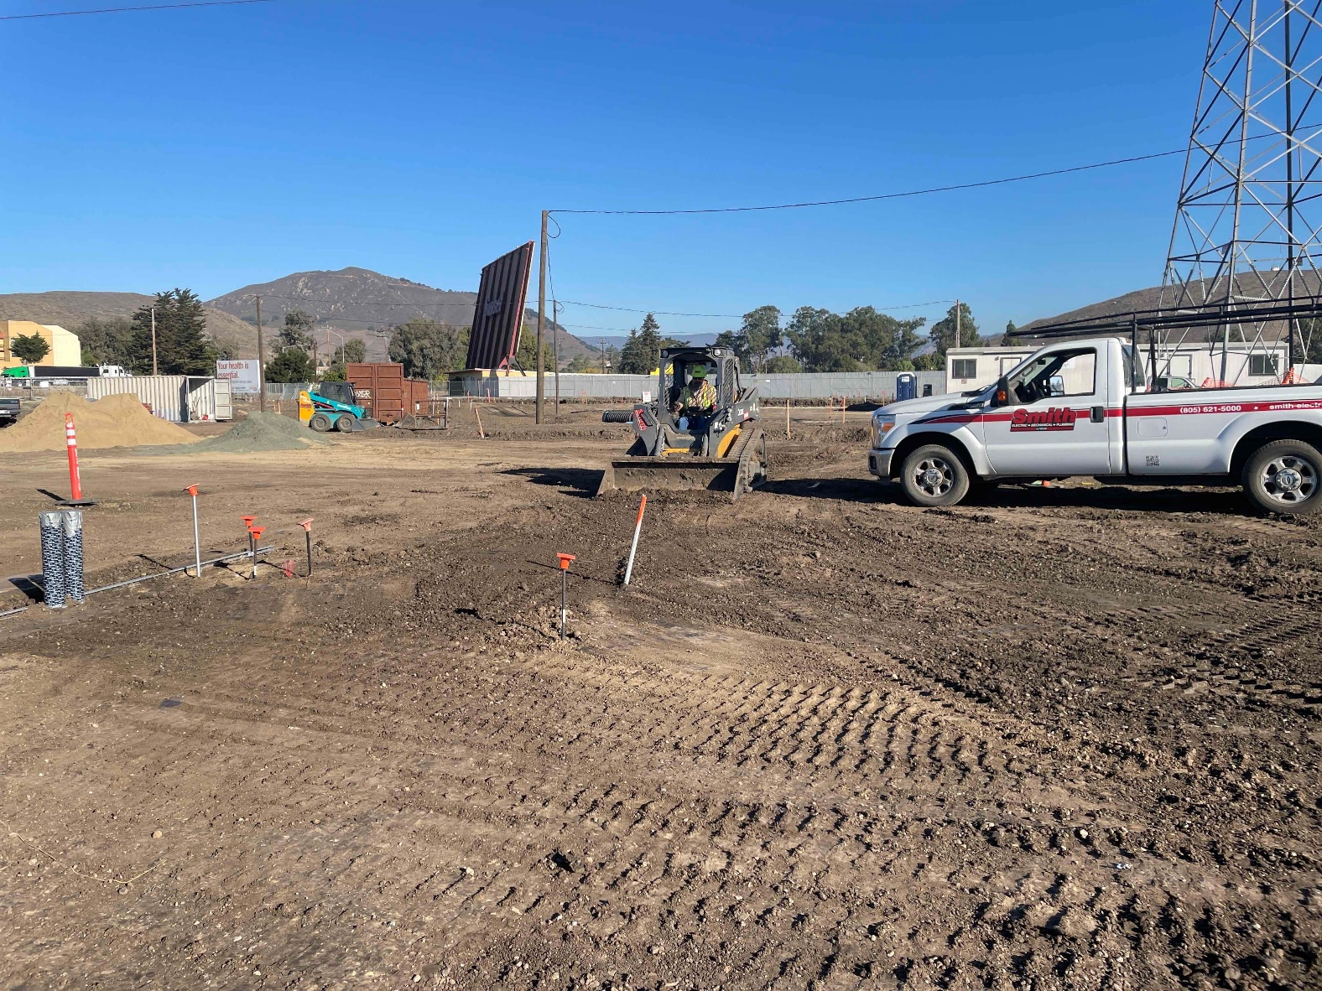
If you would like to tour the site, just let me know

Slide 5
Operations
Bus Maintenance Facility
New: Summary of RTAC meeting on Nov. 4th
Cancer awareness event on Oct. 28th
Honoring RTA bus operator Darwin Buss
Worked with American Cancer Society
Relay for Life at each of our three facilities

Slide 6
Operations
Recruitment update since last report in September:
Two new Bus Operators in service
One new Utility Worker hired
One new Bus Operators in training
Four candidates in background check
Have four open Bus Operator positions

Slide 7
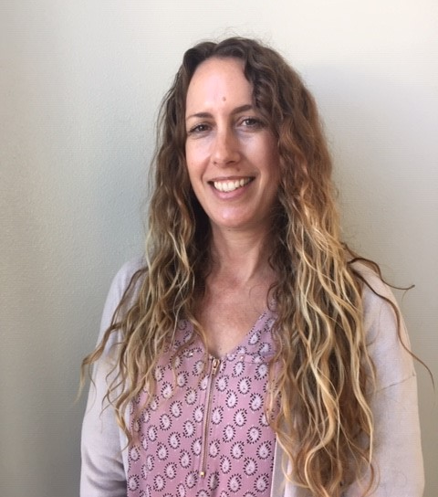
New Accounting Technician
Allison Stitzer

Slide 8
Operations
RTA providing Bus Operator and Utility worker coverage for SoCo Transit
Employee shortages have stabilized
Should shortage worsen due to COVID-19, may be forced to cut service
Possibly revert to modified Saturday schedule
I would alert City Managers and RTA Board prior to announcing any emergency service cuts

Slide 9
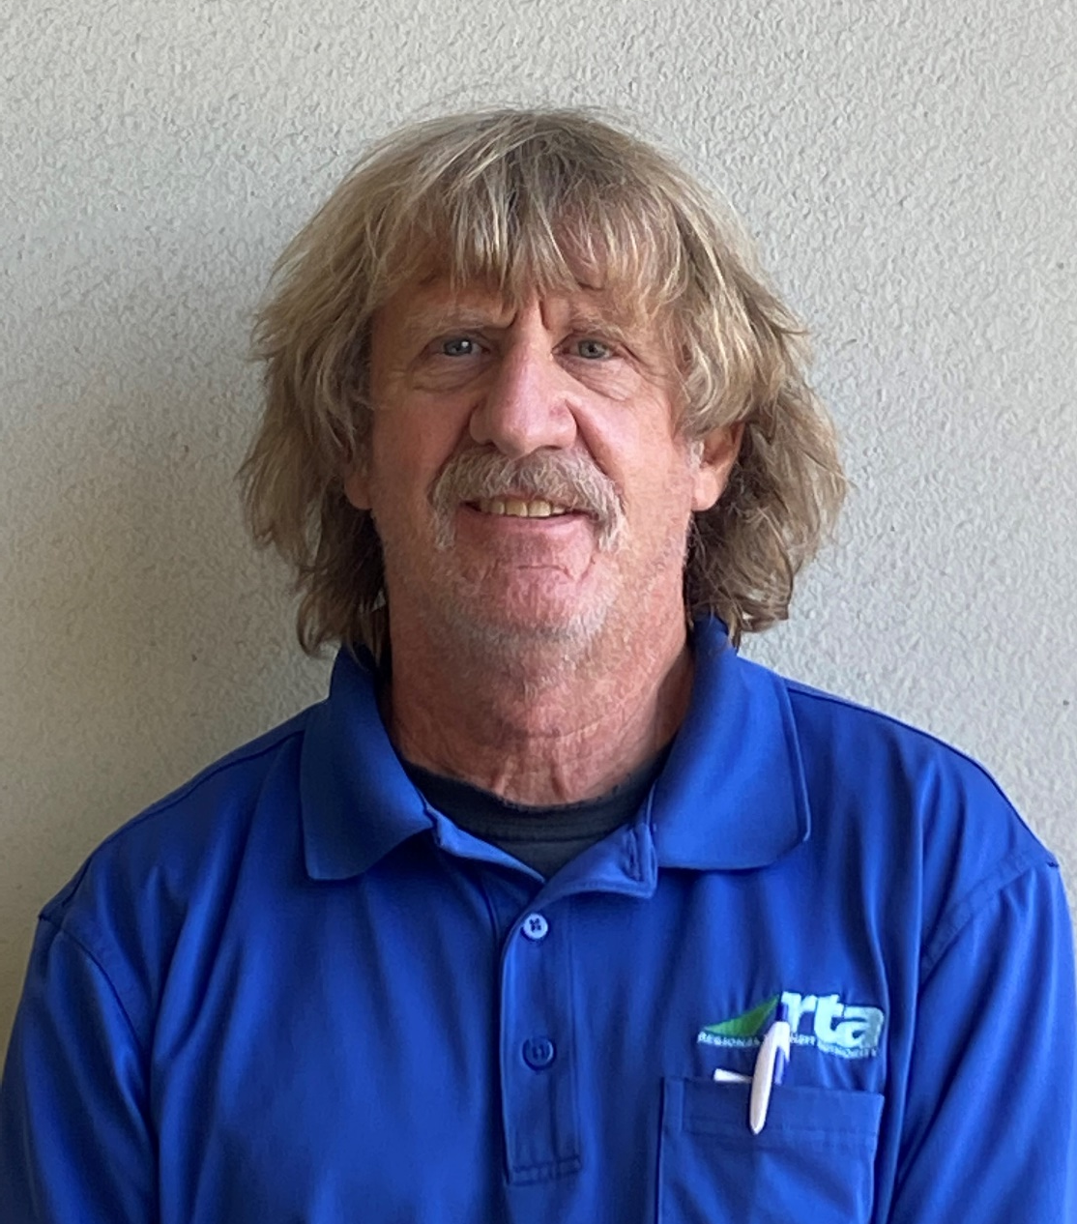
Operations
Employee of the Quarter
CB Bidleman

Slide 10
Service Planning & Marketing
Bus replacement process for City of Paso Robles
Purchase two 40-foot buses
Remaining four smaller Paso Express buses will be phased out
Replace two Paso Dial-a-Ride vans
Holiday Schedule: Saturday schedule for the week of Christmas to New Years

Slide 11
Service Planning & Marketing
Employee survey completed and feedback shared with RTA management team
Marketing focused on COVID-19 related service changes & safety protocols
RTA website includes Spanish translation tool

Slide 12
Finance & Administration
CPS HR Consulting: Diversity and Inclusion survey delayed to December 7-8
Unaudited operating and financial results for YTD 20/21. COVID-19 has impacted demand:
Fixed-Route down 60.5%
Runabout down 61.8%
Productivity declines; see page B-1-7 for details

Slide 13
Finance & Administration
Unaudited Financial Results:
Overall non-capital expenses below budget at 20.6% through 25% of the fiscal year
Administrative Costs at 21.3%
Vacancy in Accounting Tech position, professional development budget largely unused, and marketing costs are low as we curtail efforts to promote ridership
Service Delivery Costs at 20.4%

Slide 14
Finance & Administration
Farebox Recovery Ratio (FRR):
Drastically reduced due to interim cash fare of 50¢ regular and 25¢ discounted
Fixed-Route: 2.7%
Runabout: 2.6%
Suspension of FRR penalties during the pandemic
Subsidy per Passenger Boarding:
Fixed-Route: $21.28
Runabout: $138.59

Slide 15
Staff Recommendation
Receive and File

Slide 17
San Luis Obispo Regional Transit Authority
December 2, 2020
AGENDA ITEM: B-1
TOPIC: Fiscal Year 2020-21 Operating Budget Amendment #2 – Reduction of LTF Required from Jurisdictions
RECOMMENDATION: Approve FY 2020-21 Budget Amendment #2
PRESENTED BY: Tania Arnold, Deputy Director/CFO

Slide 18
Budget Amendment #2
This amendment reduces the LTF required from the jurisdictions
FY20-21: $105,209
Projection for FY21-22: $1,018,940
Additional FTA 5307 CARES funding from Santa Maria Urbanized Area
Does NOT include Phase 2 of 5311 CARES funds
Allocation of STA funds revised down at the October 7th SLOCOG Board meeting

Slide 19
Budget Amendment #2
FY20-21 Changes to operating revenue and expenses:
Reduce debt service reserve – now being spent with the close of the TIFIA loan in September 2020
Increase in offset reserve carryover to FY21-22
Increase in FTA 5307 CARES from Santa Maria UZA – balance to capital
Decrease in LTF required

Slide 20
Budget Amendment #2
FY20-21 Changes to capital revenue and expenses:
Decrease equipment replacement reserves and STA for the current year due to decrease in STA allocation from SLOCOG
Increase in FTA 5307 CARES from Santa Maria UZA for COVID related capital items
Increase in revenue and expense related to bus maintenance facility due to refined schedule
Increase in loan repayments (interest)

Slide 21
Budget Amendment #2
FY21-22 Advisory changes to operating revenue and expenses:
Revised reserves
Revised STA based on reduced STA in FY20-21 assuming same lower number moving forward
Use of offset reserve carryover generated in FY20-21
Reduction in office space rental

Slide 22
Budget Amendment #2
FY21-22 Changes to capital revenue and expenses:
Revised reserves
Revised STA based on reduced STA in FY20-21 assuming same lower number moving forward
Revised revenue and expense related to bus maintenance facility due to refined schedule

Slide 23
Budget Amendment #2
For Reference:
Amendment for City of Paso Robles:
For FY20-21: Revised STA
For FY21-22: Revised STA and revised projected LTF
Amendment for the County of San Luis Obispo:
For FY20-21: Revised STA and revised PROJECTED RTF
Beach Trolley anticipated cost savings not included
For FY21-22: Revised STA

Slide 24
Agenda Item B-1 Recommendation
Adopt Budget Amendment #2 as presented.

Slide 26
San Luis Obispo Regional Transit Authority
December 2, 2020
AGENDA ITEM: B-2
TOPIC: SoCo Transit Consolidation into the SLO RTA
RECOMMENDATION: 1. Approve Amended/Restated RTA JPA
2. File necessary paperwork with Secretary of State
PRESENTED BY: Geoff Straw

Slide 27
Overview of Issues
Benefits of consolidation (originally presented in January 2018):
Lower admin oversight/audit/planning costs, and lower vehicle-related insurance costs.
Increased costs for employee health care and work comp.
Most importantly: avoid future Farebox Recovery Ratio penalties.
Result: Net operating cost savings through consolidation.
Timeline: Implementation effective 12:00 AM Jan 1, 2021
Local Control: South County Transit Committee (SCTC)
Comprised of RTA Board members from Arroyo Grande, Grover Beach, Pismo Beach and one member from Board of Supervisors

Slide 28
Staff Recommendation
Approve the attached Resolution ratifying the San Luis Obispo Regional Transit Authority Amended and Restated Joint Powers Agreement.
Following approval of the Amended and Restated JPA, direct staff to file necessary paperwork with the California Secretary of State.

Slide 30
San Luis Obispo Regional Transit Authority
December 2, 2020
AGENDA ITEM: B-3
TOPIC: Fiscal Year 2020-21 RTA Budget Amendment #3 for SoCo Transit Consolidated into the RTA as of January 2021
RECOMMENDATION: Approve Budget Amendment #3
PRESENTED BY: Tania Arnold, Deputy Director/CFO

Slide 31
Budget Amendment #3
This amendment does NOT have an impact on LTF required for FY20-21
Additional columns in RTA budget to include services provided for South County, changes noted in yellow
Also presenting advisory FY21-22 budgetary information

Slide 32
Budget Amendment #3
Operating Revenue (page B-3-5)
FY 2020-21
No changes to RTA
Additional column for SoCo Transit
FY 2021-22
Slight reduction in revenue for administrative services $20,980
Additional column for SoCo Transit

Slide 33
Budget Amendment #3
Capital Revenue (page B-3-7)
No changes to RTA
Additional columns for SoCo Transit

Slide 34
Budget Amendment #3
Administration and Service Delivery Totals (B-3-8)
Rollup of all non capital items for all services the RTA provides
Capital Expenditures Totals (B-3-9)
Rollup of all capital items for all services the RTA provides

Slide 35
Budget Amendment #3
South County Transit Detailed Expenditures (B-3-10)
By-route expenditures with the additional column showing the advisory FY21-22 projections
FY 2020-21
Expenditures are in line with the expenditures from budget amendment #2 for half the year
Exception is funding needed for additional health insurance expense in Labor-Operations line item
FY 2021-22
Reduced charges for administration services
Reduction in insurance due to duplicative administrative charges

Slide 36
Agenda Item B-3 Recommendation
Adopt Budget Amendment #3 as presented.

Slide 38
C-1 Executive Committee Meeting Minutes of August 12, 2020 (Information)
C-2 RTA Board Meeting Minutes of August 5, 2020 (Approve)
C-3 RTA Board Meeting Minutes of September 2, 2020 (Approve)
C-4 Procurement of Replacement Vehicles (Approve)
C-5 Declare Vehicles Surplus (Approve)
C-6 Designate Executive Director as Alternate on CalTIP Board (Approve)
C-7 BMF Construction Change Order Summary (Approve)
C-8 Final Social Security Resolution for RTA Employees (Approve)
C-9 Annual Fiscal & Compliance Audit for Fiscal Year 2019-20 (Accept)
C-10 Cuesta College Proposal for Transit Improvements at North Campus (Approve)
Staff Recommendation:
Approve the Consent Agenda

