Slide 1
AGENDA ITEM: A-1 TOPIC: Administrator’s Report Recommendation: Accept as Information PRESENTED BY: Geoff Straw
South County Transit
April 26, 2017

Slide 2
Driver’s Forum on March 14 : -Possible schedule revisions to Rts 27/28 from Ramona Garden -Rt 21 possible use Halcyon or Brisco vs Grand from WalMart -Address early departures on all routes
Operations

Slide 3
Operations
-Consider re-routing Rt 27 from ECR to Branch -Issue of riders exhibiting strong odors -GFI had trouble with new SCT fare-cards

Slide 4
Operations
Driver Appreciation Day on March 17
-Bagels & Coffee for drivers
-Admin staff rode buses
-Collected feedback from riders

Slide 5
Marketing & Service Planning
SBCAG leading the Santa Maria to SLO Public Transportation Connections Study
-On bus surveys on April 25th
-Study will take 12 months

Slide 6
Finance & Administration
APC system achieved FTA Certification
More accurate rider counts
SCT 167,211 riders through March 31
13.7% decline (fares & fuel)
FRR is 11.65%
Remains below TDA required 20%

Slide 7
Finance & Administration
Comparing March 2016 to March 2017
SCT-only: 63% in 2016 vs 56.3% in 2017
SCT-only Day Pass: 10.3% of total
Day passes eliminated free transfers
Day Passes or Cash: 48.8% in 2016 vs. 43.3% in 2017
Use of Regional 31-Day Pass: Increased from 9.2% to 16.8%

Slide 8
Finance & Administration
Total operating expenditures at 70.6% (75% of the fiscal year)
Amended SCT JPA
Was not awarded Caltrans Planning Grant
Seek FTA funds to conduct SRTP in 2018
SB1 Discussion

Slide 10
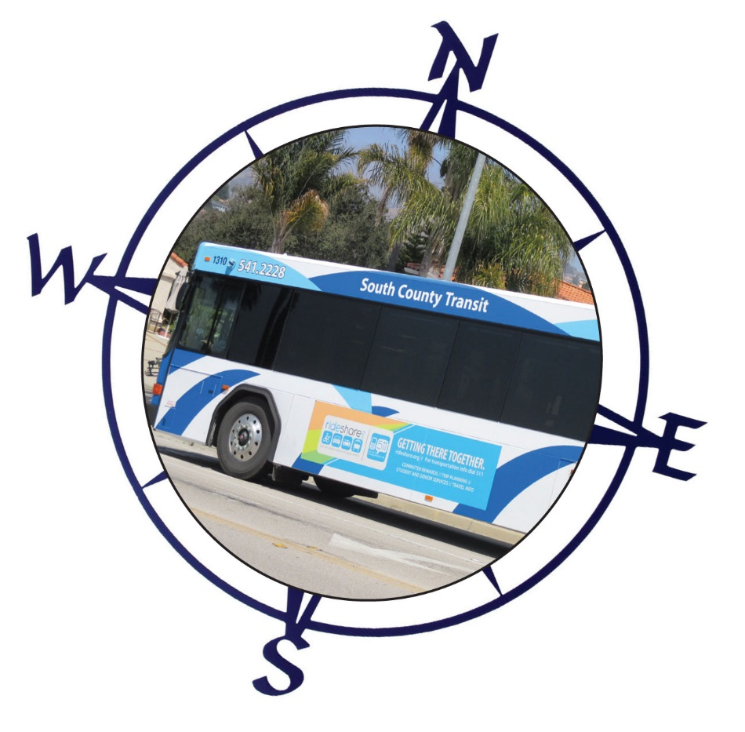
South County Transit
Fiscal Year 2017/2018
Projected Five Year Capital Budget
April 26, 2017

Slide 11
OPERATING REVENUE SOURCES
County (Avila) $57,060
Fares $154,420
Federal $562,020
Fund Balance $45,820
Interest $7,370
Local (LTF) $441,640
LCTOP $134,420

Slide 12
LOCAL TRANSIT FUNDS

Slide 13
CAPITAL REVENUE SOURCES
Local (STA): $71,500
Federal: $129,080
35.6%
64.4%

Slide 14
ADMINISTRATION & SERVICE DELIVERY
Contingency $13,850
Fuel $199,280
Insurance $171,120
Salaries/Benefits $611,270
Maintenance $197,550
RTA Staff Time $119,270
Other $56,180
Property Rental $30,600

Slide 15
VEHICLE CAPITAL EXPENDITURES BY SERVICE TYPE

